Slide 1

OVERVIEW
Introduce myself
My approach
Possible plans (up to discussion)
A small introduction to a classic machine learning problem: linear regression

Slide 2
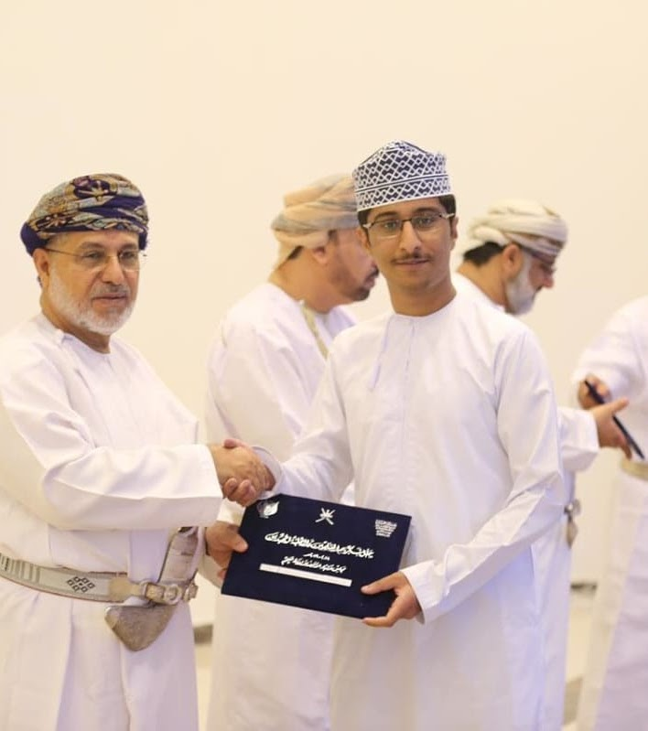

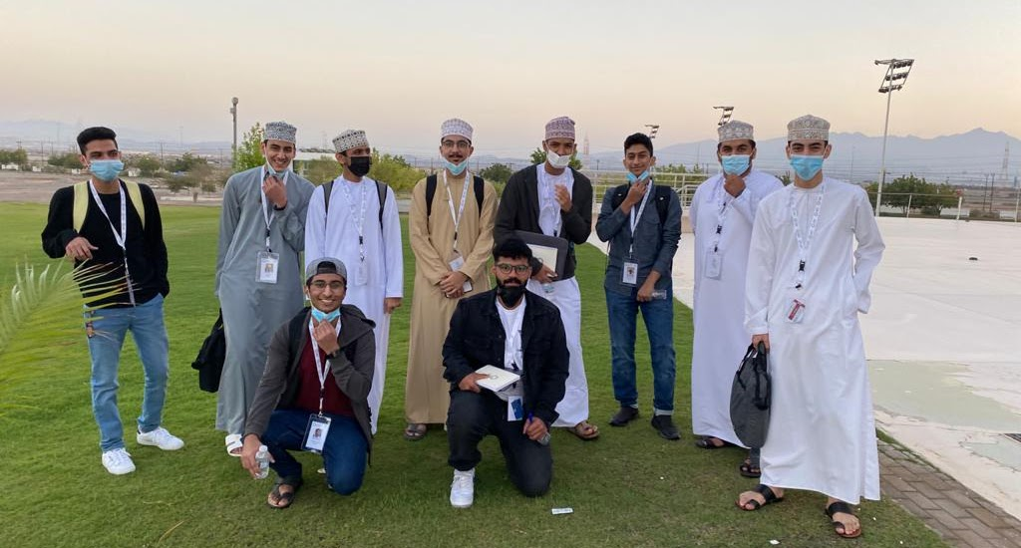
Introducing myself
Name: Mujtaba Mohammed Hussein Ali Hussein Al Ajmi
Nationality: the Sultanate of Oman
An International Takatuf Scholar
Passions: Mathematics, Computer Science, AI

Slide 3
My approach
Engage everyone
Practicality if possible
Build up deep understanding and problem solving skills
Most importantly: make sure everyone is enjoying their time

Slide 4
Possible Plans
ALL OF THESE COULD BE DONE IN COMBINATION!
Game development
Some kind of way of showcasing everyone’s work
Web development
Coding problems (Leetcode)
Machine Learning

Slide 5

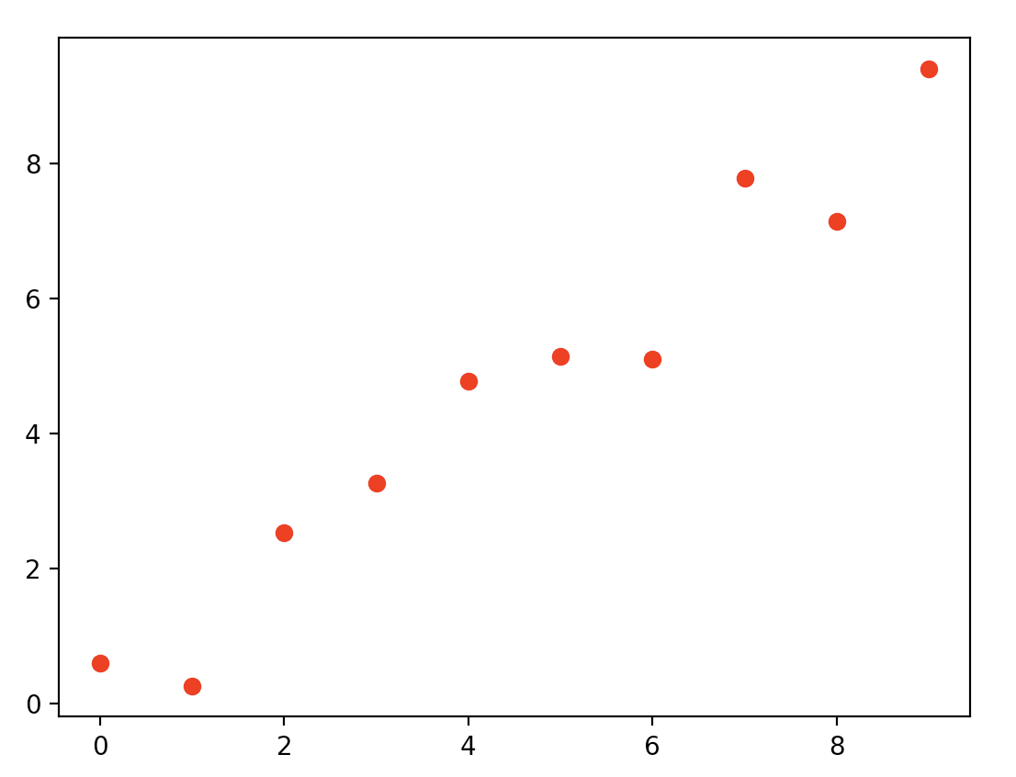
Linear regression
Area of house (km^2) | Prize ($100,000)
0 | 0.60115643
1 | 0.26579862
2 | 2.53585449
3 | 3.26009248
… | …
10 | 9.39838682

Slide 6
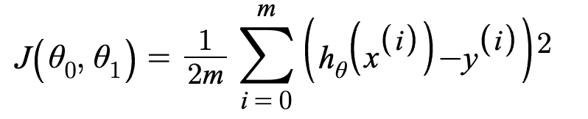
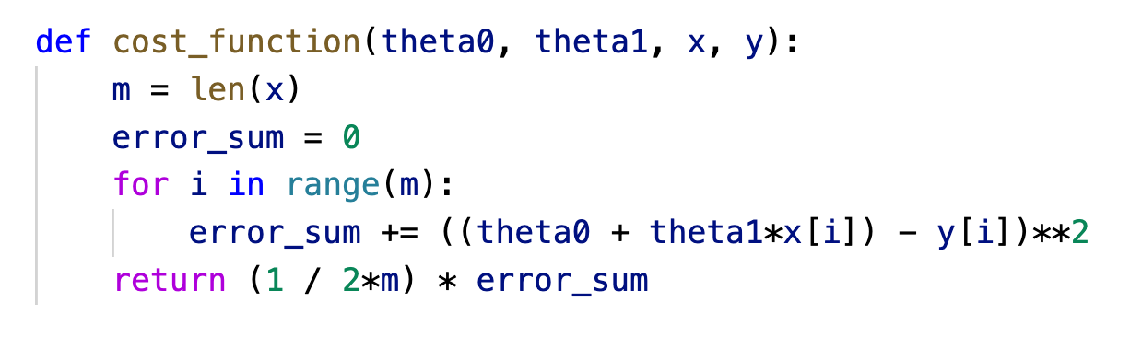
Loss (cost) function
Our objective is to minimize the chosen loss function!

Slide 7
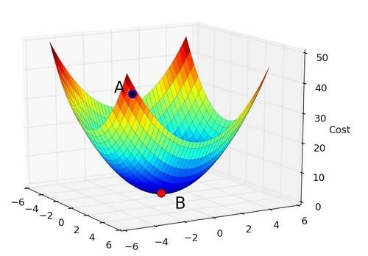

Slide 8

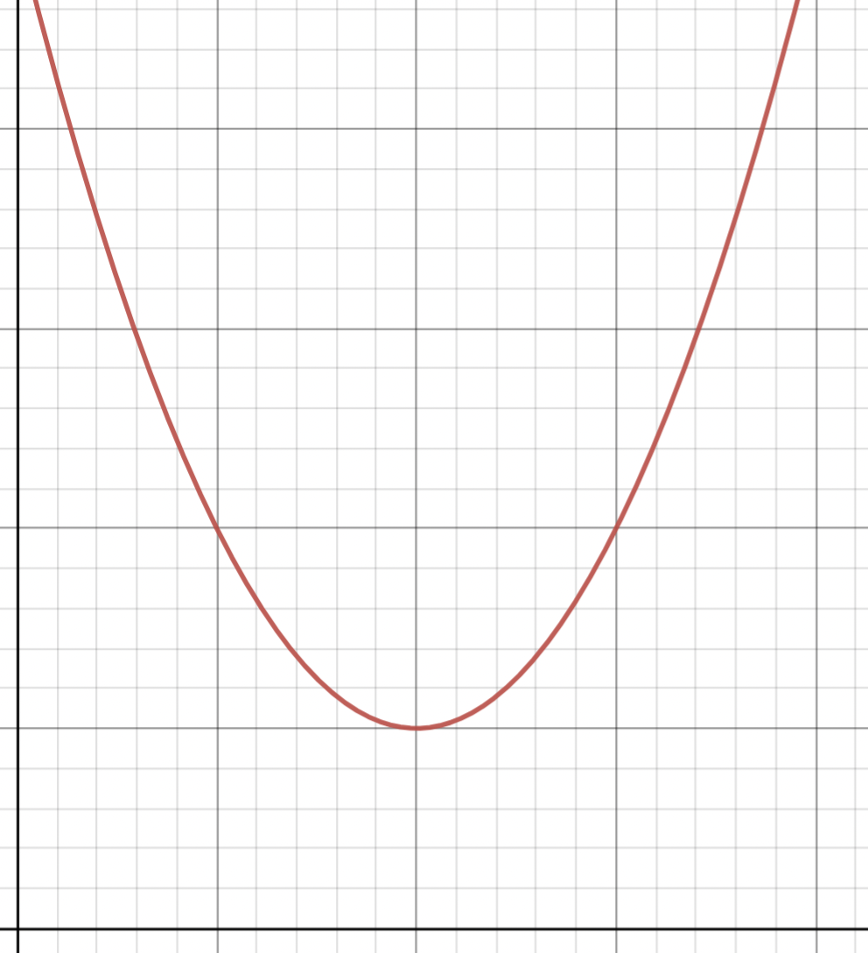
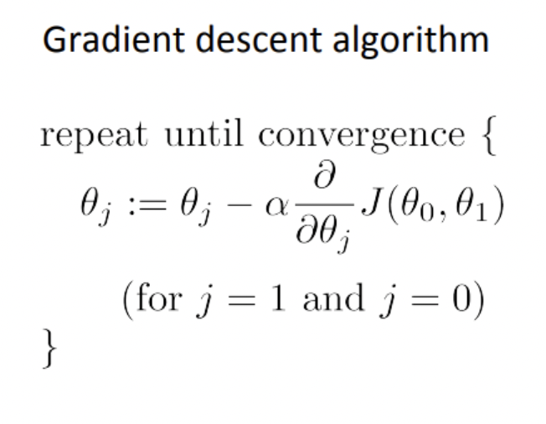
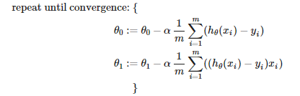


Slide 9
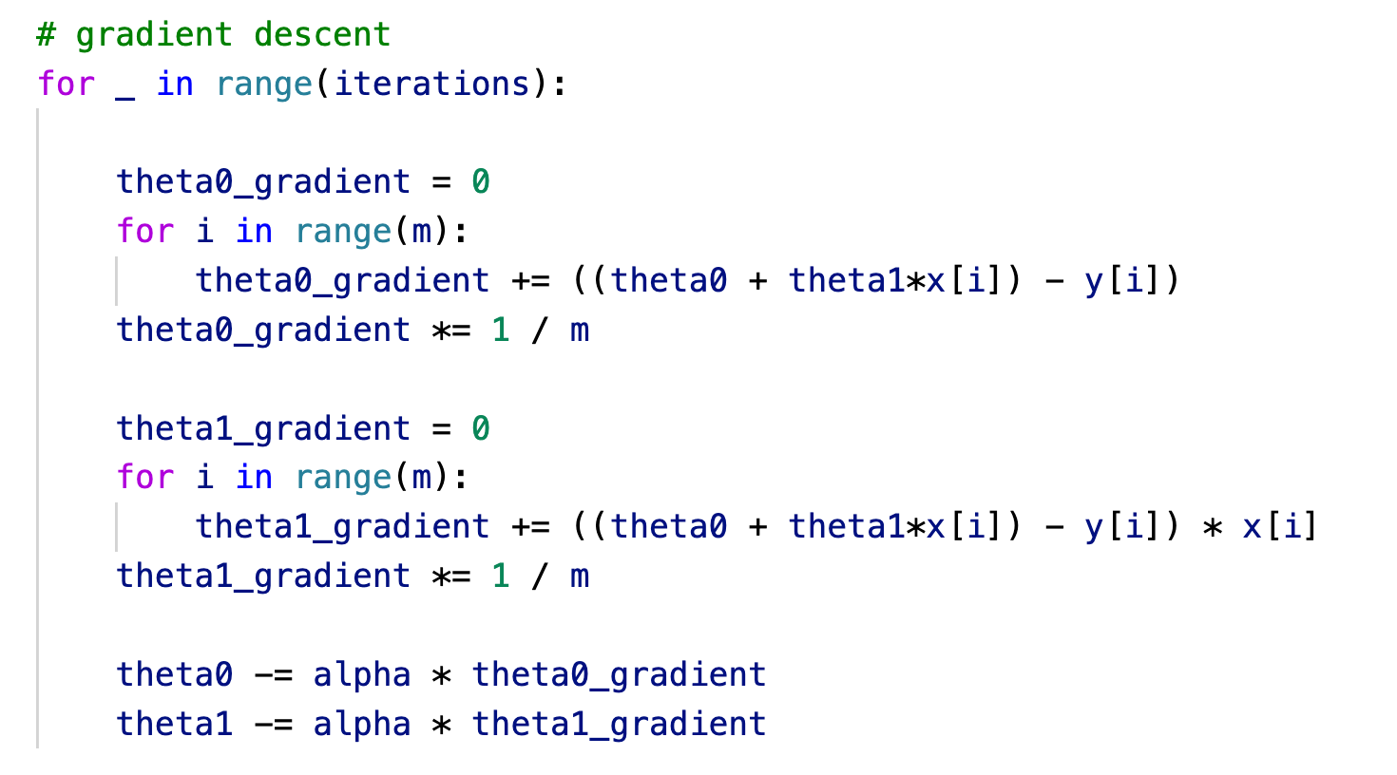
Non-vectorized approach

Slide 10
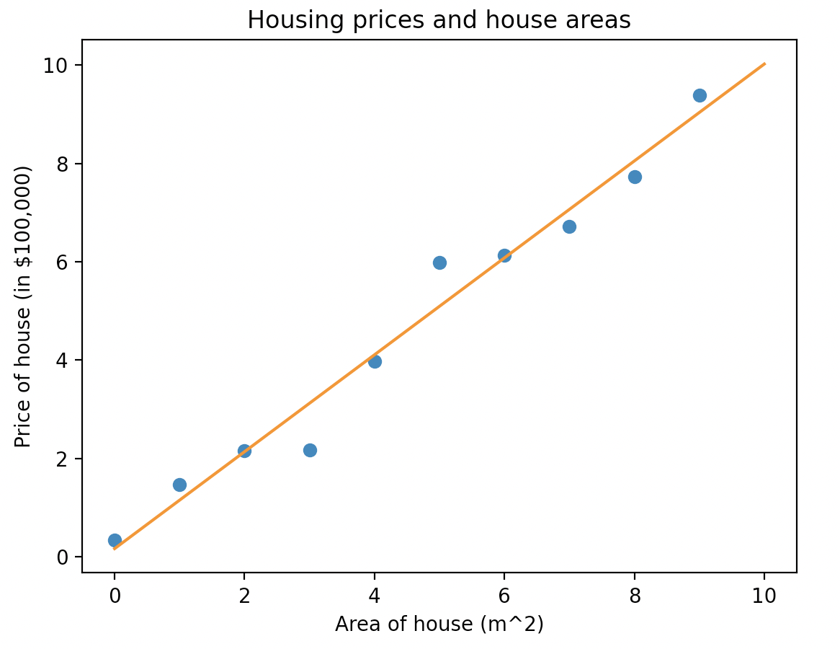

Slide 11
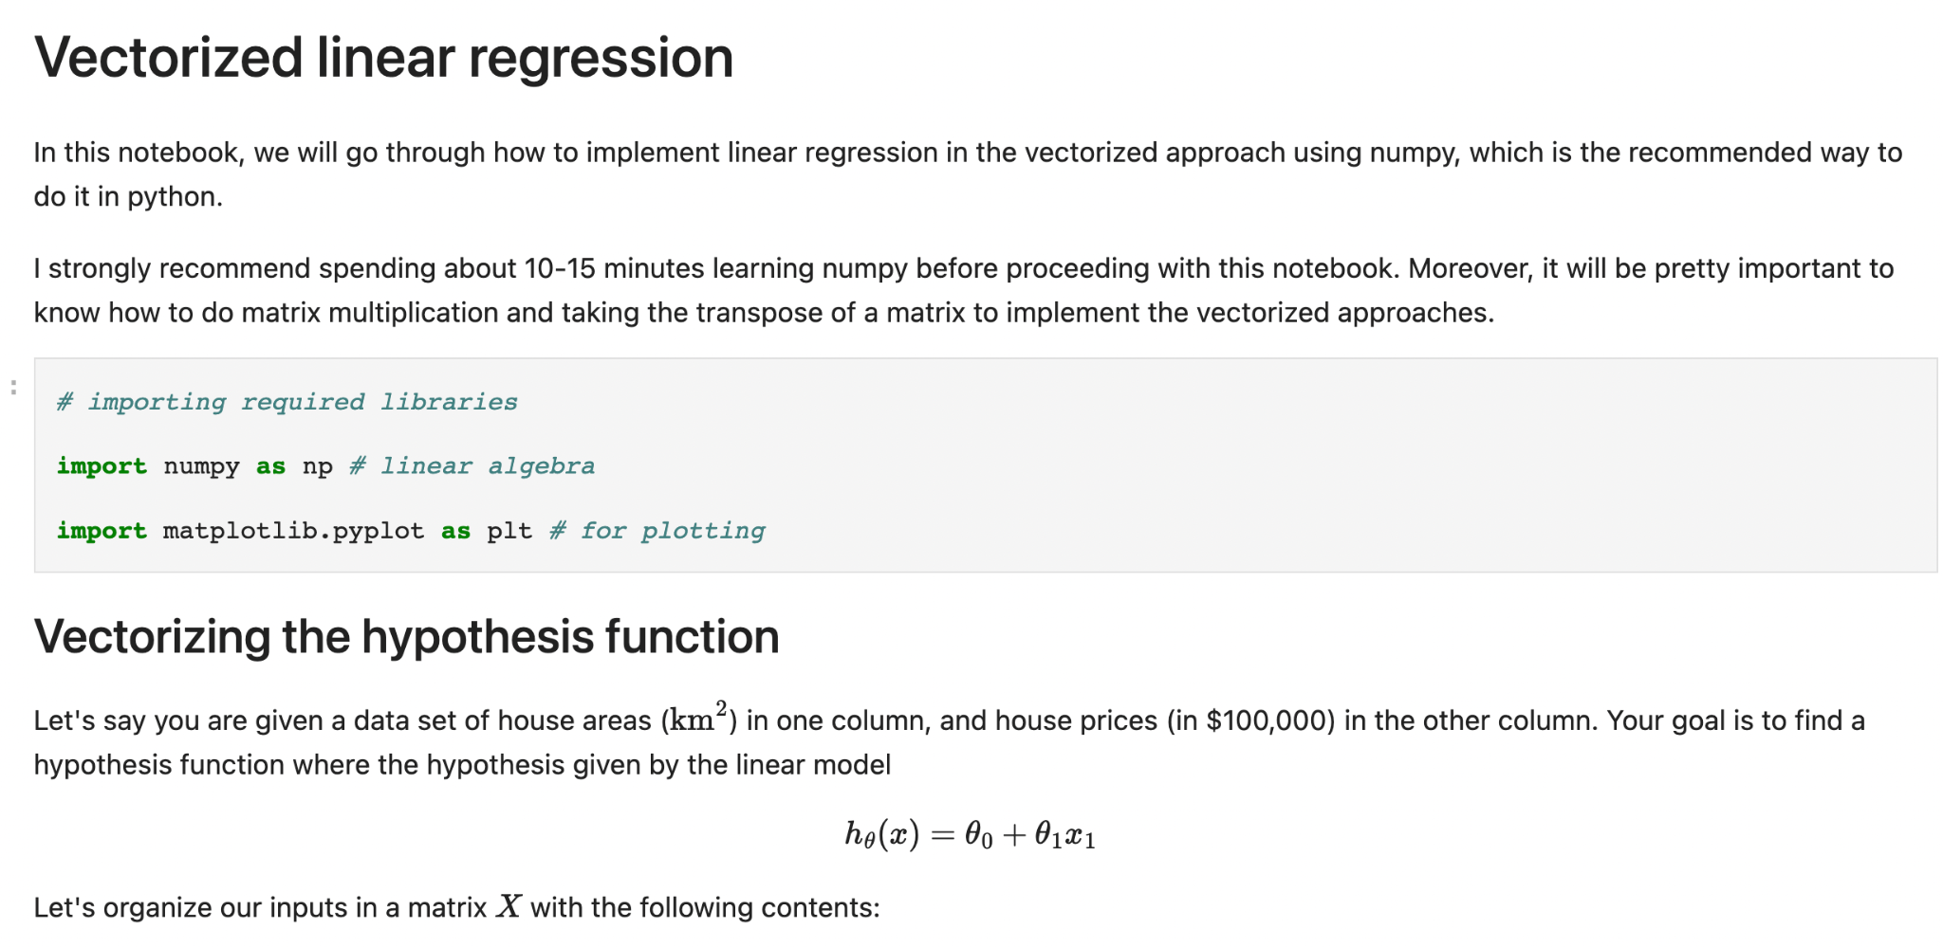
For those who are interested!
https://github.com/mujtabaalajmi/machine-learning-presentation

